Slide 1
JavaScript and the HTML5 Canvas
IN712 Web 3

Slide 2
Intro
HTML5 graphical power is often mentioned in web development circles
Games can be written that run in the browser
Flash has been made obsolete by HTML5
Actually this power doesn’t come from HTML5, except in the sense that the new standard introduces an element that works as a drawing surface
All the actual awesomeness is accomplished by JavaScript talking to the canvas element
There is too much for us to do everything, so we will look only at the core; if you’re interested in doing serious art work in the browser, an appropriate reference text is essential

Slide 3
HTML5 Canvas Element
Here’s the basic workflow…
HTML
JavaScript
<canvas>
Get reference to canvas
Ask canvas for reference to context
Send drawing commands to context

Slide 4
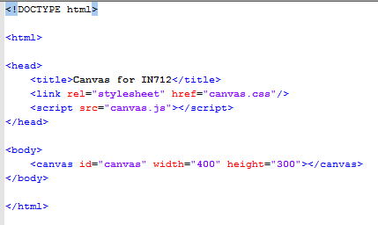
The HTML

Slide 5
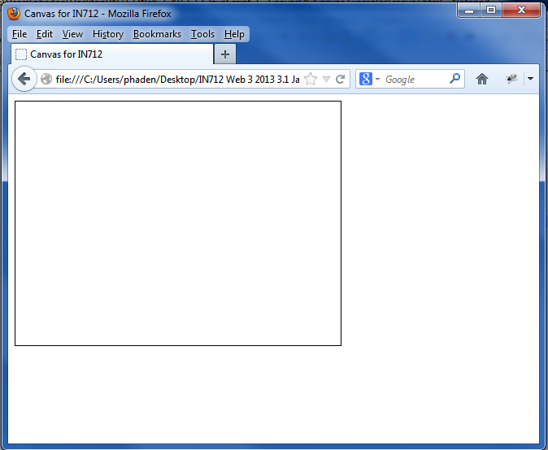
The HTML
And here is how it renders in the browser….
The canvas is transparent and empty.
I’ve CSS’d a border around it so you can see where it is

Slide 6
Note of caution
We have here a CSS file as well, which you can still use for ordinary CSS things like layout and text styling, but the canvas is driven almost exclusively from the JavaScript
One thing to note here is the width and height settings for canvas. This is something of an anomaly in the behaviour of the element.
The width and height attributes of canvas are not the same as the width and height properties you can style in CSS (i.e. if you write a CSS rule for canvas and say width: value or height: value).
The HTML attributes are the “real” dimensions and the CSS properties are the displayed dimensions. If these values aren’t the same, the system scales from the real dimensions to the display dimensions.
That is, if your HTML attribute dimensions are 100 by 100, and you change the CSS width and height in the CSS to 200 x 200, the canvas doesn’t enlarge, it stretches. Its contents will become pixelated.
However, if you change the actual element attribute values (using the DOM reference inside JavaScript) the element actually gets larger.
So it is always best to size your canvas by its HTML element attributes as shown here (or in the JS)
If you don’t specify dimensions in the element tag, you get a default of 300 by 150

Slide 7

The JavaScript
We will first need a reference to the object in the DOM
However, the canvas itself is not the drawing surface. The canvas is an object that contains a drawing surface. Actually, it contains (in theory) multiple drawing surfaces, and we need to specify which we want.
These drawing surfaces are called contexts, and we can get a reference to one by invoking the canvas object’s getContext method
In most browsers, you can only ask for the 2D canvas at the moment. But the object is defined like this to allow for a 3D canvas in the future, when browser technology is able to do 3D rendering.
Here is a very basic example:
The fillrect method takes x,y of the upper left corner, width and height (all in pixels).
Because we haven’t specified otherwise, we get the default look for shapes, which is just filled in black.

Slide 8
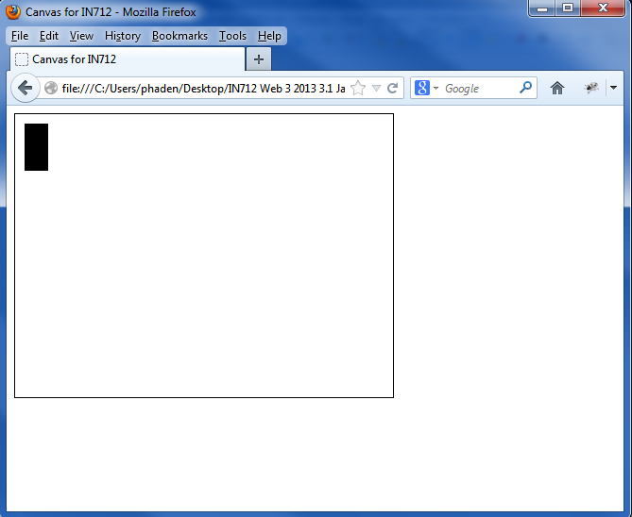
The Render

Slide 9
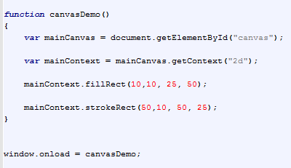
Fill and Stroke
HTML5 canvas distinguishes between the fill and the stroke (the inside of a shape and the outline of a shape)

Slide 10
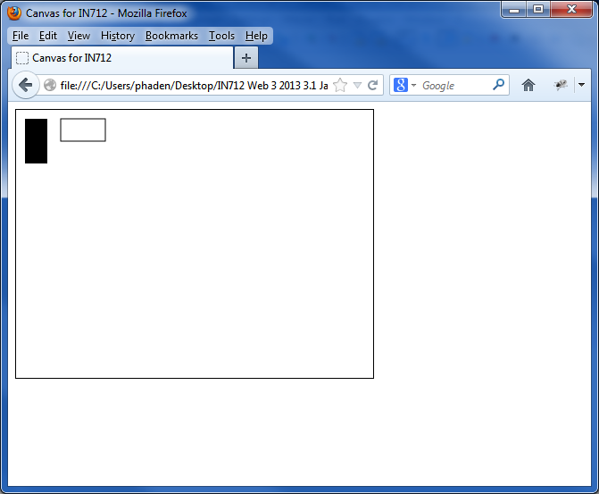
Fill and Stroke

Slide 11
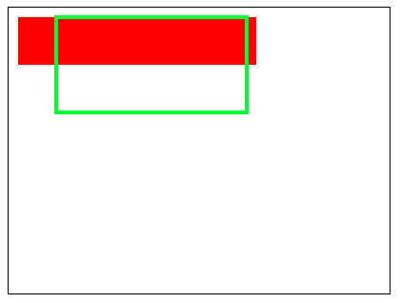
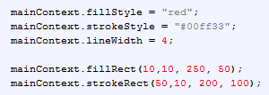
Fill and Stroke
To change the colours of the stroke or fill, use the strokeStyle and fillStyle properties (watch the capitalisation)
context.fillStyle
context.strokeStyle
context.lineWidth

Slide 12
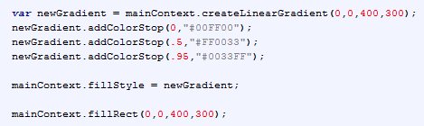
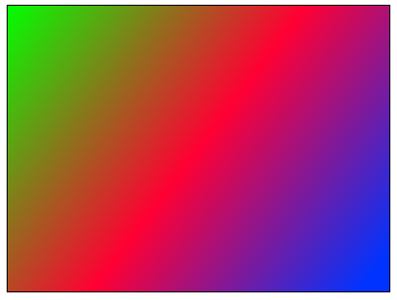
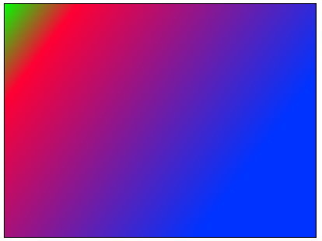
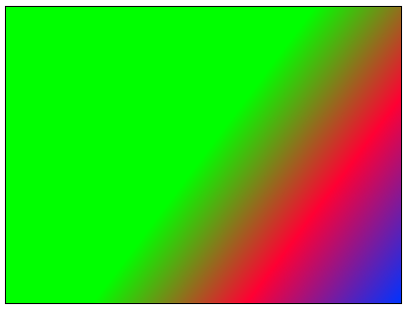
Complex fillStyle

Slide 13
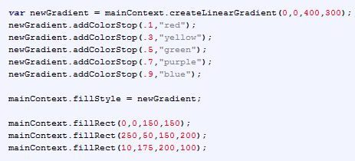
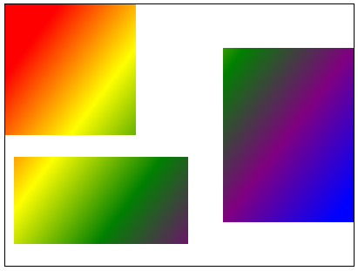
Gradients (continued)
If you define the gradient object to be a large space, and then call fillRect on subportions of the space, it makes cut-outs, as shown.

Slide 14
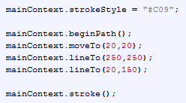
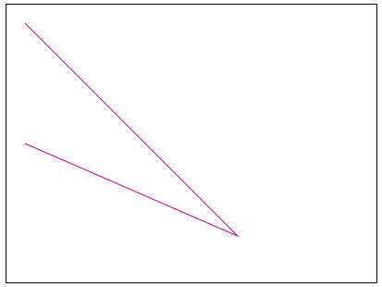
Drawing Paths
Path = sequence of connected line segments
To make paths (sequences of connected lines) you begin the path, define the segments, stroke the path, and end the path.

Slide 15
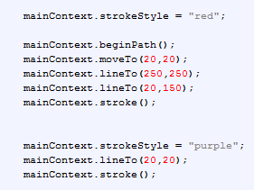
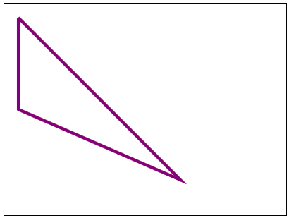
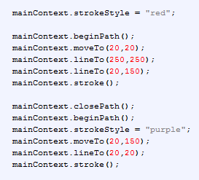
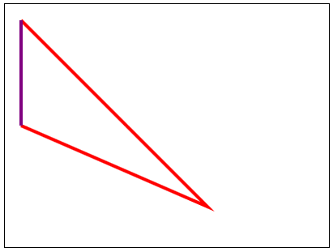
Drawing Paths
No red. The last stroke strokes the whole path.
How to do this second figure?
Close the first path and start a new one.
There’s more to paths as well, like you can bevel or round the junctions between lines.

Slide 16
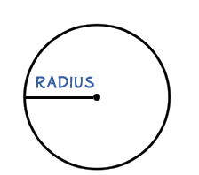
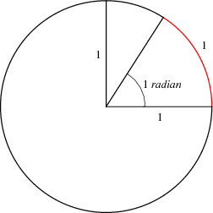
Drawing Arcs
You will have noticed that we have only been drawing straight lines.
Of course, we need to be able to draw circles, ovals, etc.
Canvas does this by drawing arcs
context.arc(x, y, radius, startAngle, endAngle, antiClockwise)
x: starting x coordinate
y: starting y coordinate
radius: the radius of the circle the arc lies upon
The radius of a circle is the distance from the center of a circle to any point on the circle.
startAngle: position (in radians) on the circle where the arc begins (0 = due east)
The radian is the standard unit of angular measure. One radian is just under 57.3 degrees
endAngle: position (in radians) on the circle the arc ends
antiClockwise: boolean determining the direction of drawing (default = false)

Slide 17
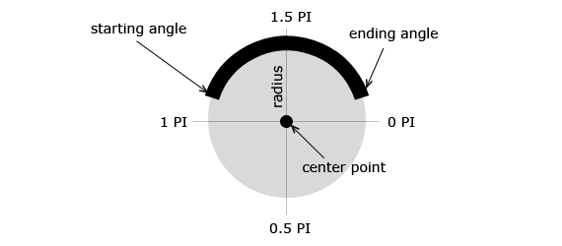
Drawing Arcs
context.arc(x, y, radius, startAngle, endAngle, clockwise)

Slide 18
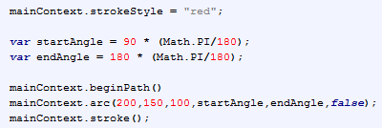
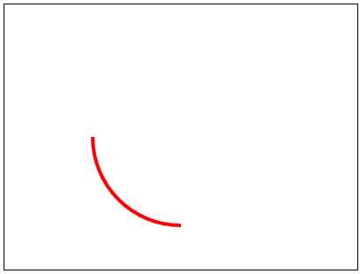
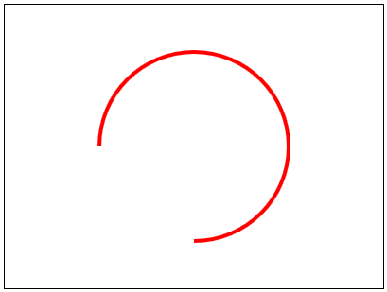
Drawing Arcs – What will this code draw?
What happens if we change the clockwise argument from false to true?

Slide 19
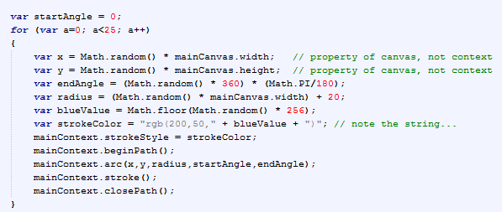
Drawing Arcs
Try to guess what this code will do…

Slide 20
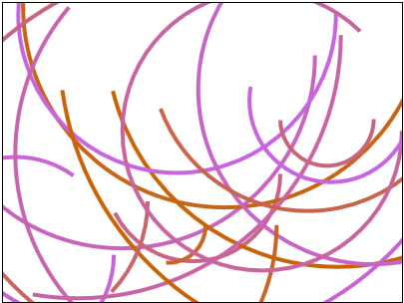
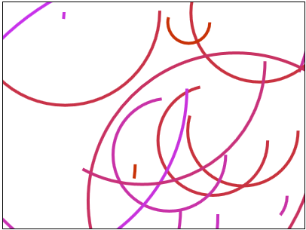
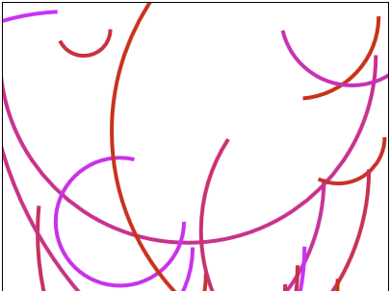
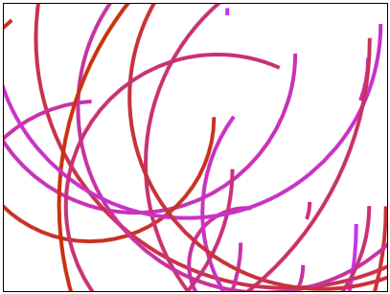
Drawing Arcs

Slide 21
Working with Images
drawImage( imageObject,
sourceX,
sourceY,
sourceWidth,
sourceHeight,
destX,
destY,
destWidth,
destHeight);

Slide 22
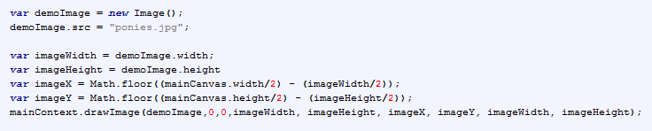

Working with Images

Slide 23

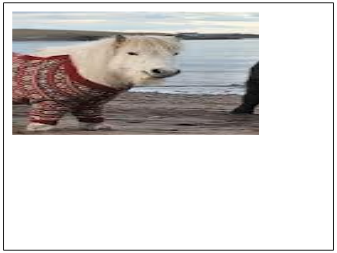
Working with Images
Starting at 50,50 in the source image, it copies a 100 x 150 pixel rectangle
It then draws that, starting at 10,10 on the canvas and stretches it to cover a 300x150 pixel area.

Slide 24
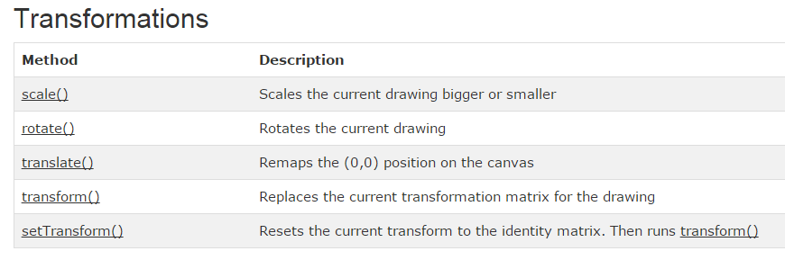
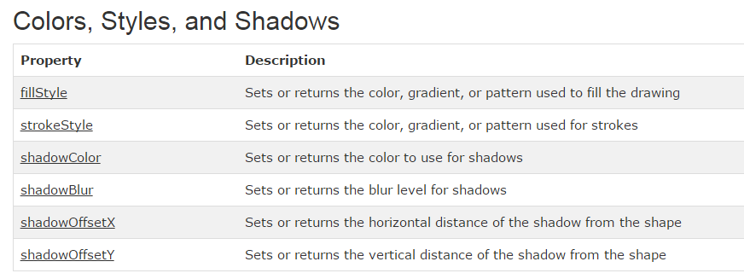

Slide 25
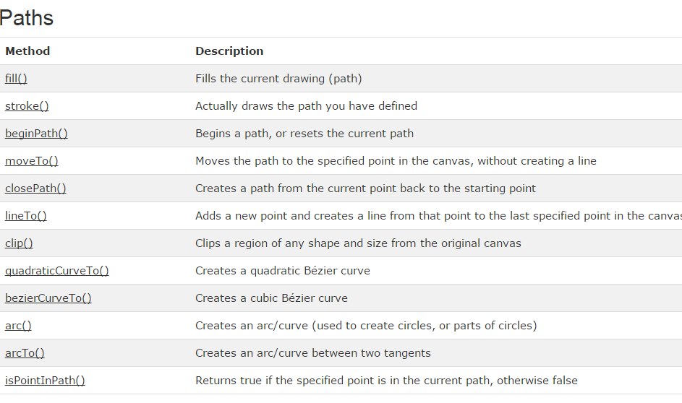

Slide 26
Timers in a Web Page

Slide 27
Stopping a Timer

Slide 28
Animation Clock
Drawing is good; animation is better.
To achieve the clock cycle required for animation (serial frequent presentation of images) in Javascript we use the setInterval method.
This is a method of the global object (it is fine to think of it as a method of the page, or the application), so you can call it from pretty much anywhere.
setInterval(function object, interval)
setInterval returns an identifier
To stop looping, pass the id to clearInterval(id)

Slide 29
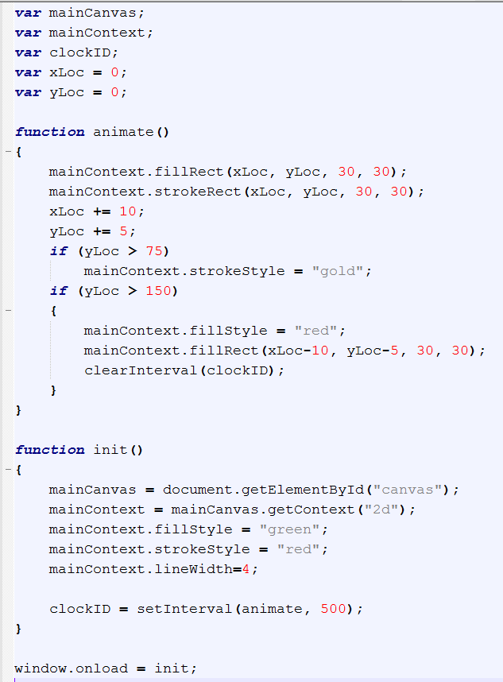
What will this code do?
First globals, then init, including the call to setInterval and storage of the interval identifier, then the callback animate()

Slide 30
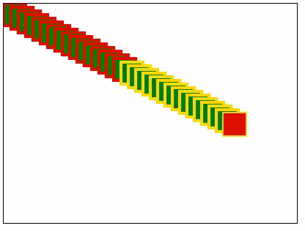
Output

Slide 31
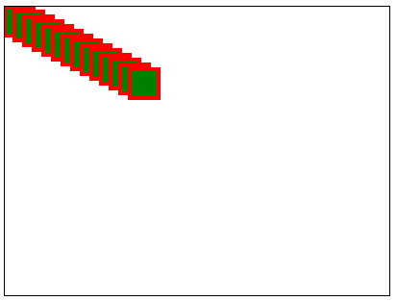
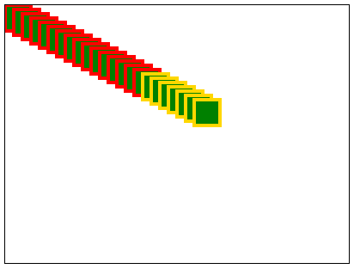
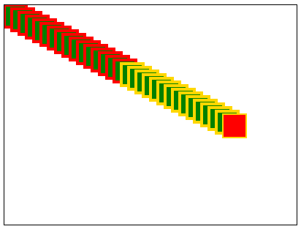
Output
After about 10 ticks…
After tripping the first conditional..
When it stops…

Slide 32
Demo
http://liveweave.com/wKmjvy

Slide 33
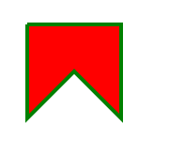
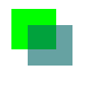
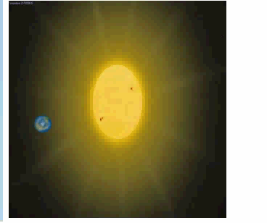
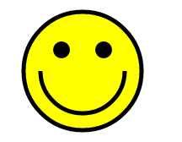
Practical

